Slide 1
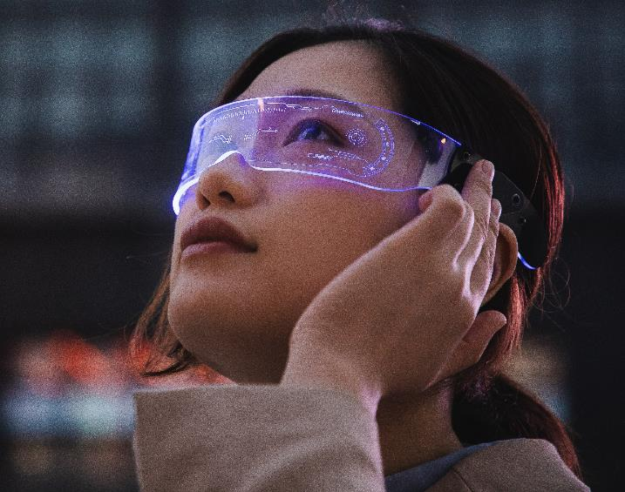
Iris scanner
Submitted by: Drashti Devani
Exam No: 3384
Guided by :
Prof. Khushbu Surati

Slide 2
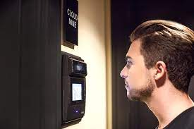
OVERview
1.
1. Iris
2. History
3. structure and working
4. Iris television and movies
5 . Applications
6 . Advantages
7. Disadvantages
8 . Future scope
9. Conclusion
10. References

Slide 3
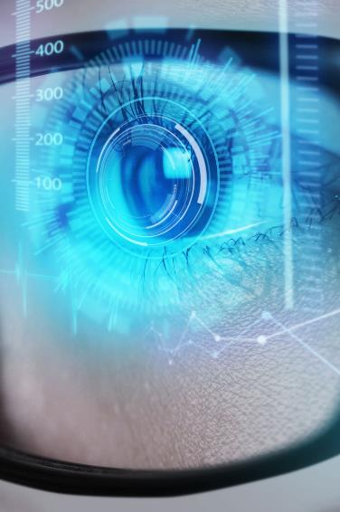
1. what is iris scanner ?
iris scanning is the process of using visible and near-infrared light to take a high-contrast photograph of a person’s iris. It is a form of biometric technology in the same category as face recognition and fingerprinting.
Iris scanner is a biometric method of identifying people based on unique patterns within the ring-shaped region surrounding the pupil of the eye. Every iris is unique to an individual, making it an ideal form of biometric verification.
Iris scanners are security systems of biometrics. They are used to unlock doors and in other security application. during the 2015s iris scanners become commonplace on mobile phone.
People have a different color pattern on their eyes. The this eye cannot be removed or changed . So, it is widely useful in the market.

Slide 4
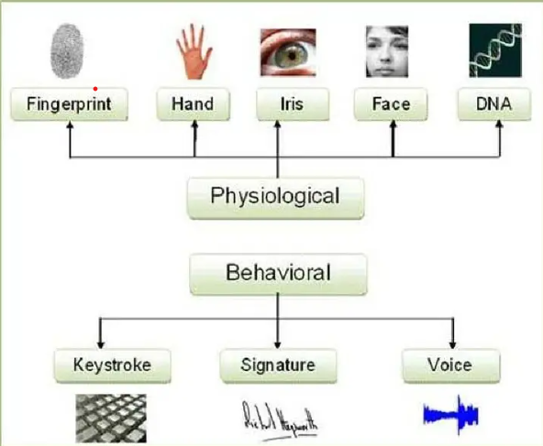
1.2 biometric
A biometric system is essentially a pattern recognition system which makes a personalidentiﬁcation by determining the authenticity of a speciﬁc physiological or behavioral char-acteristic possessed by the user.
Characteristics fall into two categories :
Physiological are related to the shape of the body
2. Behavioural are related to the behavior of a person

Slide 5
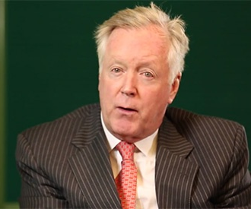
2. History of scnner
The concept of iris scanner was first propesed by Dr. Frank Burch in 1939.
It was first implemented in 1990 when Doctor John Daugman created the algorithms for it.
Those algorithm employee methods of pattern recognitions and some mathematical calculation for iris scanner.

Slide 6
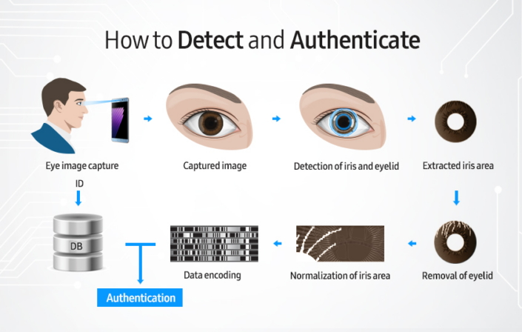
3.structure and working of scanner
Iris recognition is an automated method of biometric identiﬁcation that uses mathematicalpattern-recognition techniques on video images of one or both of the irises of an individual’seyes, whose complex patterns are unique, stable, and can be seen from some distance.
Iris scanners collect around 240 biometric features, the amalgamation of which are unique to every eye. The scanners then create a digital representation of that data. That numeric representation of information extracted from the iris image is stored in a computer database.

Slide 7
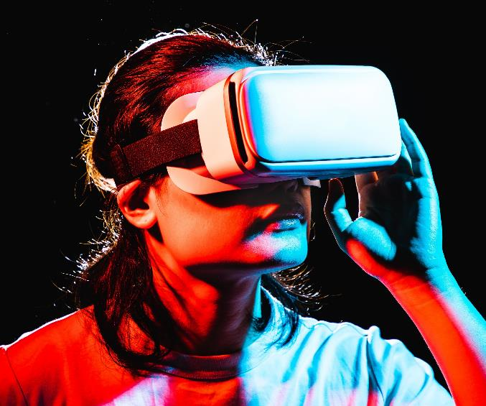
4.Iris tv and movies
NCIS uses an iris scanner in the garage, where forensic vehicle investigations are carried out and evidence is stored. There is another scanner at the entrance to MTAC.
Iris recognition systems do not use the laser like beams shown in the sequence and the light that they do use is near-infrared and nearly invisible.

Slide 8
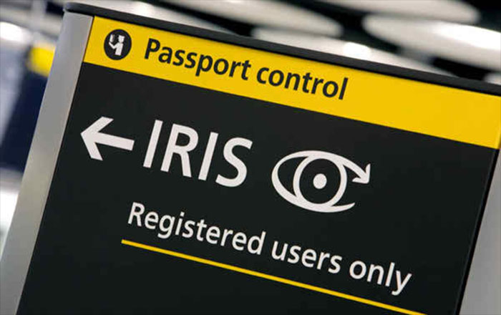
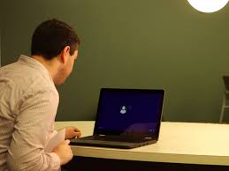
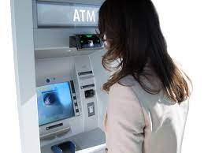
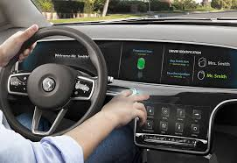
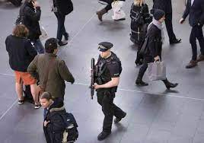
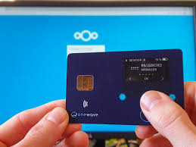
5. applications
Border controls
Computer login
Cash machine
Anti terrorism
credit card
Auto-mobile

Slide 9
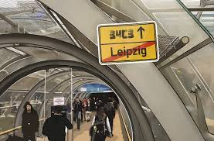
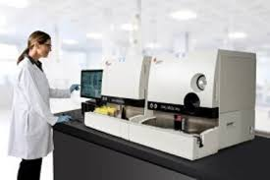

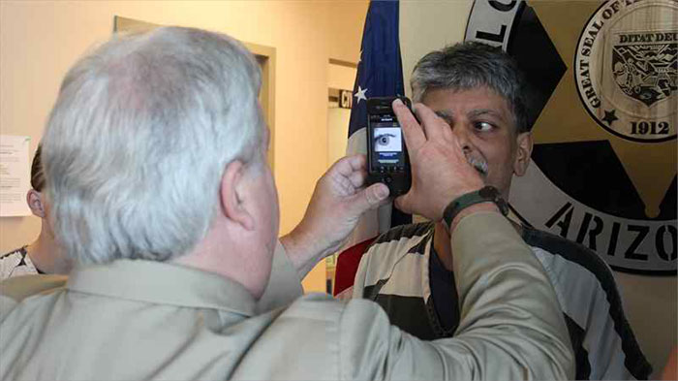
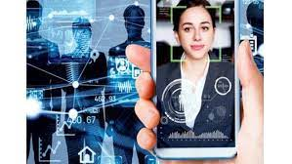
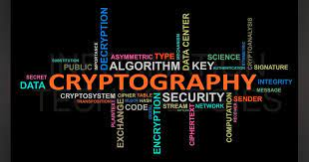
ticketless travel
home, office, laboratory
Internet security
cryptography
tracing missing
authorization

Slide 10
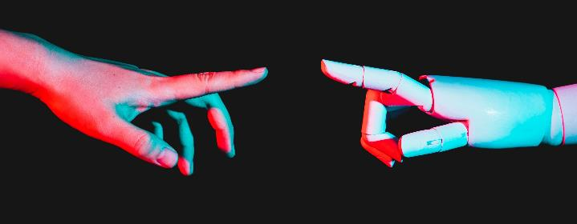
6 . Advantages
Easy to use authentication
High Authentication
identification anyone individual
physical and behaviour characteristics
high ability to apply
high community acceptance
automatic real times
life cycles

Slide 11
7. Disadvantages
Accuracy change with users’s Height, illumination, image quality etc .
Persons need to be still difficult to scan if not co-operated.
Risk of fake ice lenses
Alcohol consumption causes deformation in Iris pattern
Most expensive
maintenance requirement.

Slide 12
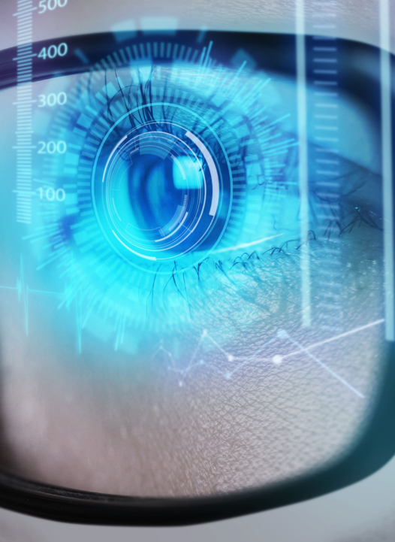
8 . Future scope
To make the study more useful and effective the following suggestion have been proposedfor further improvements in this area
To develop improved algorithms and data capturing sensors to reduce the level of failureto enrol and failure to acquire rate.
To study additional type of noises like off-angle iris images may be more useful. A lowquality and degraded eye images have been considered here.
To concern to security analysis of the proposed hybrid mechanism on noisy irises whenthe lower or upper eyelids and eyelashes cover the pupil of the iris.

Slide 13

9. Conclusion
This method of identification depends on relatively unchangeable features and thus it is more accurately defined as authentication.
The extracted addition features should be able to over-come the problem of real time implementation of the process. Unsupervised classiﬁers can beused to develop the process further.

Slide 14

10. References
https://en.wikipedia.org/wiki/Iris_recognition
https://www.eff.org/pages/iris-recognition
https://recfaces.com/articles/iris-scanner
https://www.aware.com/iris-recognition/
https://www.youtube.com/

Slide 15
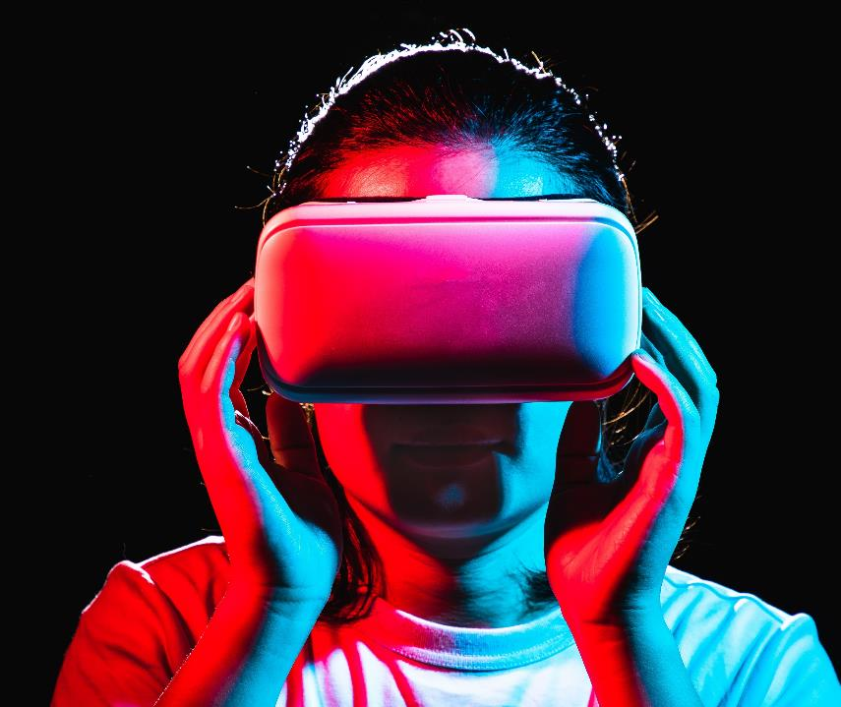
Thank you

Slide 16



